Slide 1
Unit testing basics

Slide 2
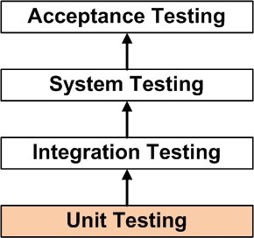
What is unit testing?
UNIT TESTING is a level of software testing where individual units/ components of a software are tested.

Slide 3
Why Is Unit Testing Important?
Reduces Defects in the Newly developed features or reduces bugs when changing the existing functionality.
Reduces Cost of Testing as defects are captured in very early phase.
Improves design and allows better refactoring of code.
Unit Tests, when integrated with build gives the quality of the build as well.
https://www.tutorialspoint.com/software_testing_dictionary/unit_testing.htm

Slide 4

Who is responsible for writing unit tests?
unit testing is a tool for the programmer and not something done by anyone else.

Slide 5
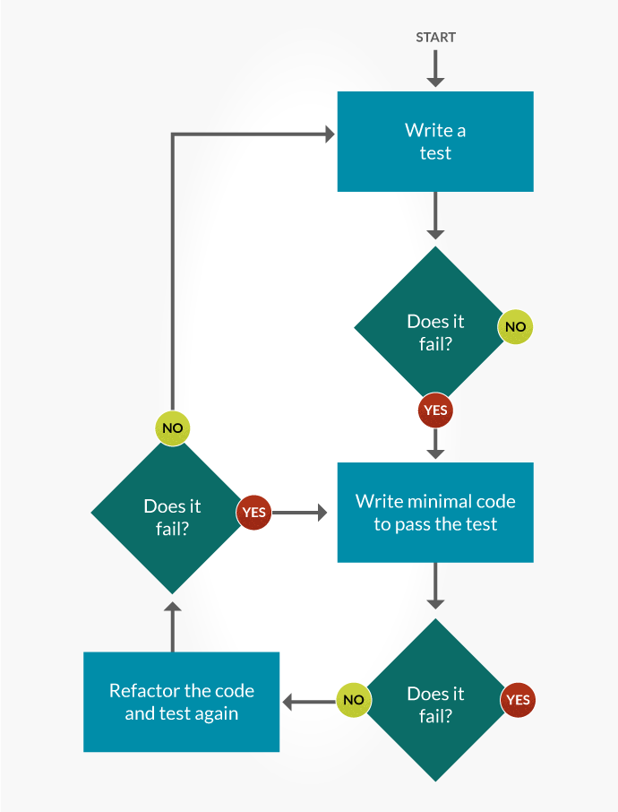
Test Driven Development (TDD)
TDD is an innovative software development approach where tests are written, before writing the bare minimum of code required for the test to be fulfilled. The code will then be refactored, as often as necessary, in order to pass the test, with the process being repeated for each piece of functionality. The below illustration shows how it works. To summaries, write minimal code and refactor continuously in order to satisfy the test.

Slide 6


Popular unit testing frameworks
Nunit – C#
Junit – Java
Jasmine & Karma – Angular
Jest – React JS

Slide 7
Reference
Art of unit testing - http://accorsi.net/docs/TheArtofUnitTesting.pdf

